Slide 1

The Eye of Indra (इंद्र-नेत्र) Smart CCTV-Based Crowd Density Monitoring & Stampede Prevention System
Prevent Stampedes & Smart Crowd Safety

Slide 2

The Human Cost of Stampedes
Stampedes and crowd crushes remain among the deadliest mass casualty events worldwide, claiming thousands of lives and leaving countless others injured. These tragedies strike without warning at concerts, religious pilgrimages, sporting events, and public celebrations.
2.5 lac
11
Bengaluru Stampede
Bengaluru stampede deaths
June 4,2025 stamped due to uncontrolled fan surge outside Chinnaswamy Stadium
2025 concert crowd surge crushing victims
100+
Annual Injuries
Hundreds harmed globally each year in crowd incidents

Slide 3




What Causes Stampedes and Crowd Surges?
Understanding the root causes is essential to developing effective prevention strategies. Stampedes rarely have a single trigger—they result from a dangerous combination of environmental, psychological, and logistical factors.
Large Gathering
Extreme Density
When thousands enter a confined area, crowd density rises quickly, reducing personal space and movement control.
When density crosses safe thresholds (5–6 people/m²), small pushes create dangerous pressure waves through the crowd.
Uncontrolled Crowd Surge
Lack of Coordination with police
Sudden mass entry—often triggered by free entry, excitement, or last-minute opening of gates—creates instant bottlenecks and compression.
Poor communication between organisers and police leads to unmanaged entry/exit flow, causing congestion and unsafe crowd buildup

Slide 4





Understanding Crowd Behavior Through Physics
Modern crowd science applies physics principles to understand how large groups move and interact. At extreme densities, human crowds exhibit behaviors remarkably similar to fluid dynamics and particle physics.
Density
More people crowding into one place increases pressure and movement risk
Pressure
Crowd pushes build up force that becomes dangerous very quickly
Waves
Small pushes travel through people like waves causing sudden instability
Panic
One persons reaction spreads fast , making the whole crowd unsafe

Slide 5
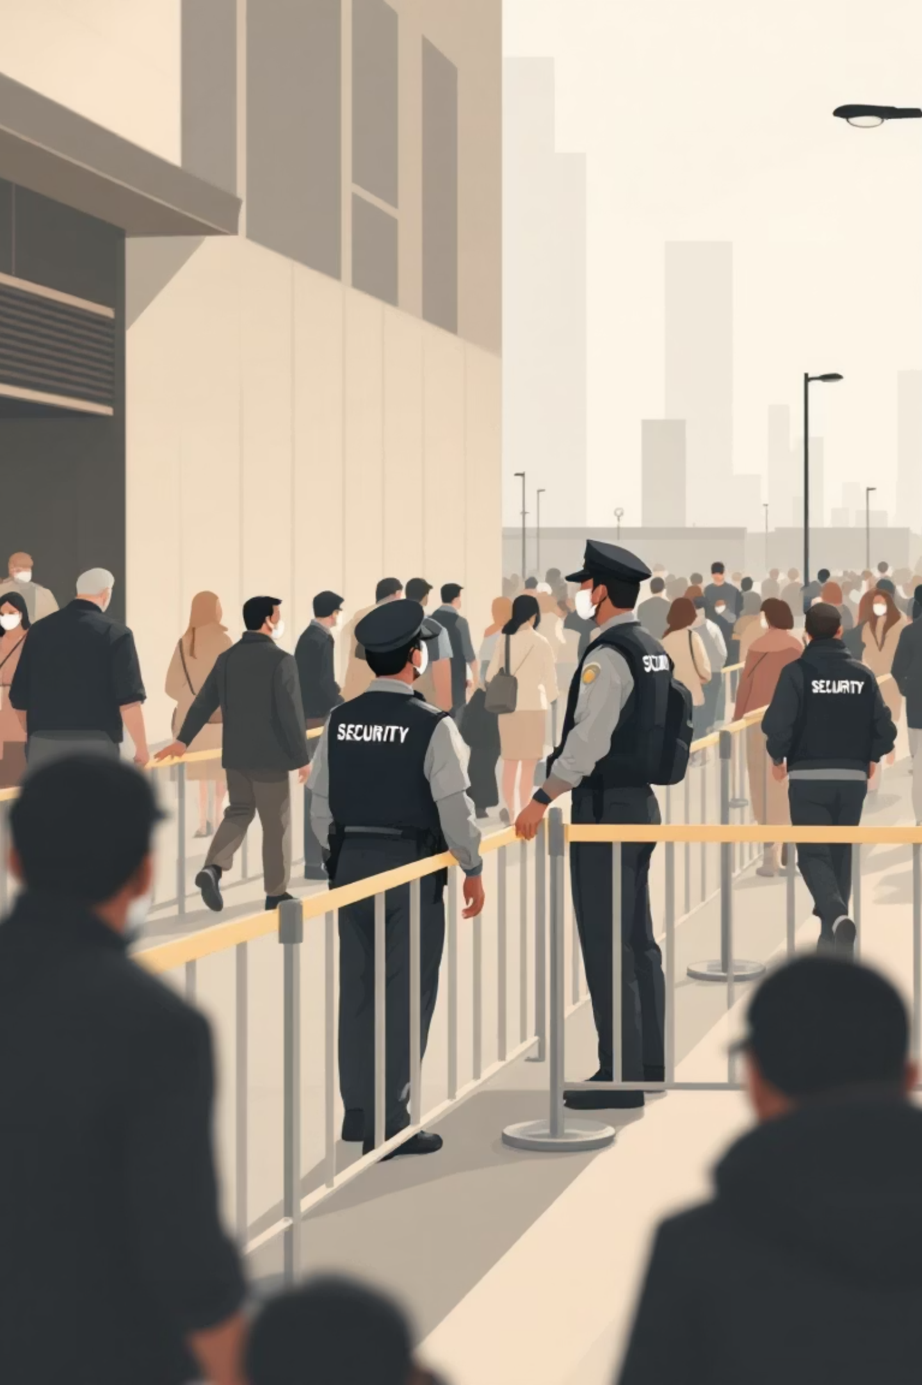
Traditional Prevention Strategies
Before the digital age, crowd safety relied on careful planning, physical infrastructure, and human vigilance. While these foundational methods remain critical, they have inherent limitations in real-time adaptability.
01
Risk Assessment & Design
Thorough evaluation of venue capacity, flow patterns, and potential hazards before
events
02
Multiple Exit Routes
Well-marked, accessible exits distributed throughout venues to prevent bottlenecks
03
Physical Barriers
Strategic placement of barriers, fencing, and crowd control structures to manage flow
04
Trained Personnel
Experienced crowd management teams and security staff with real-time monitoring
capabilities

Slide 6

AI-Powered Stampede Prevention Systems
Artificial intelligence transforms crowd safety from reactive to proactive. By processing vast amounts of visual and behavioral data in real-time, AI systems can identify dangerous conditions before they become fatal.
1
Purpose
Real-time crowd counting and density monitoring through CCTV and YOLO detection, enabling early identification
of high-risk zones before pressure builds.
2
Behavior Detection
AI detects unusual crowd behaviors—rapid surges, bottlenecks, excessive clustering, or immobile/fallen
individuals—triggering warning indicators for operators.
3
Predictive Analytics
Machine-learning models forecast crowd flow patterns to identify potential choke points, helping authorities
manage entry/exit routes more effectively.
4
Instant Alerts
Threshold-based alerts are automatically pushed to security teams when crowd density crosses predefined
safe limits, enabling immediate, coordinated action

Slide 7
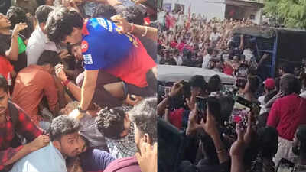
Case Study: Bengaluru (Stadium Stampede – June 4 2025)
Innovative Technology in Action
Uncontrolled Crowd Surge & Gate Entry Failure
Advanced algorithms continuously track crowd density using multiple imaging technologies
Free Entry Hype + No Entry-Flow Plan
Predefined danger levels trigger immediate warnings before critical crowding occurs
Threshold Exceeded: Capacity vs Actual Crowd
AI suggests optimal evacuation paths dynamically during emergency situations
Legal / Organisational Accountability
The Rath Yatra in Ahmedabad attracts millions of devotees annually, creating one of the world's most challenging crowd management scenarios.
Early-stage deployment shows significant potential for preventing stampedes at massive religious gatherings

Slide 8
BLOCK DIAGRAM
CCTV / IP Camera (Live Video Feed Input)
Raspberry Pi
• YOLO Person Detection • Real-Time People Counting
Backend API Server Nodejs
• Receives count from Pi • Stores data in database
• Sends alerts to frontend
Database (MongoDB ) Crowd Count Logs
• User Accounts (Owner/Admin)
• Threshold Settings
Web Dashboard (React JS)
• Live Crowd Count Display
• Threshold Input by Owner
• Visual Alerts & Indicators
ALERT SYSTEM • Red Alert on Dashboard
• Warning Sound / Popup
• SMS/WhatsApp Alert
• Instructions for Crowd Control Officers
Count > Threshold? YES │ NO
Threshold Checking Engine• Compares live count vs set threshold

Slide 9
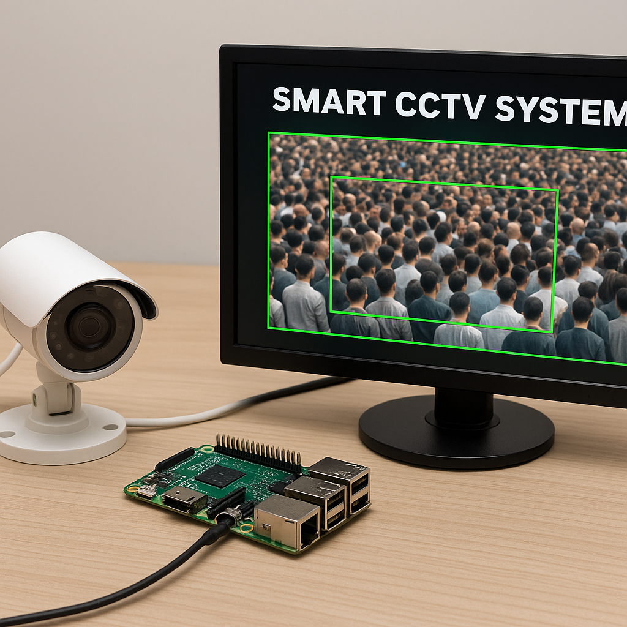


Challenges and Considerations
High Processing Requirement
Running YOLO detection on multiple CCTV feeds requires significant processing power to maintain
real-time performance without delays
Privacy & Safety Concerns
System must track crowd density without identifying individuals, ensuring compliance with privacy standards and ethical monitoring practices.
Team Coordination Needed
Smooth coordination with police, stadium staff, and event managers is essential to ensure alerts
lead to fast on-ground actions.
Correct Alert Limits
Setting accurate density limits is critical—too low causes unnecessary alarms, too high delays
warnings during real danger.

Slide 10
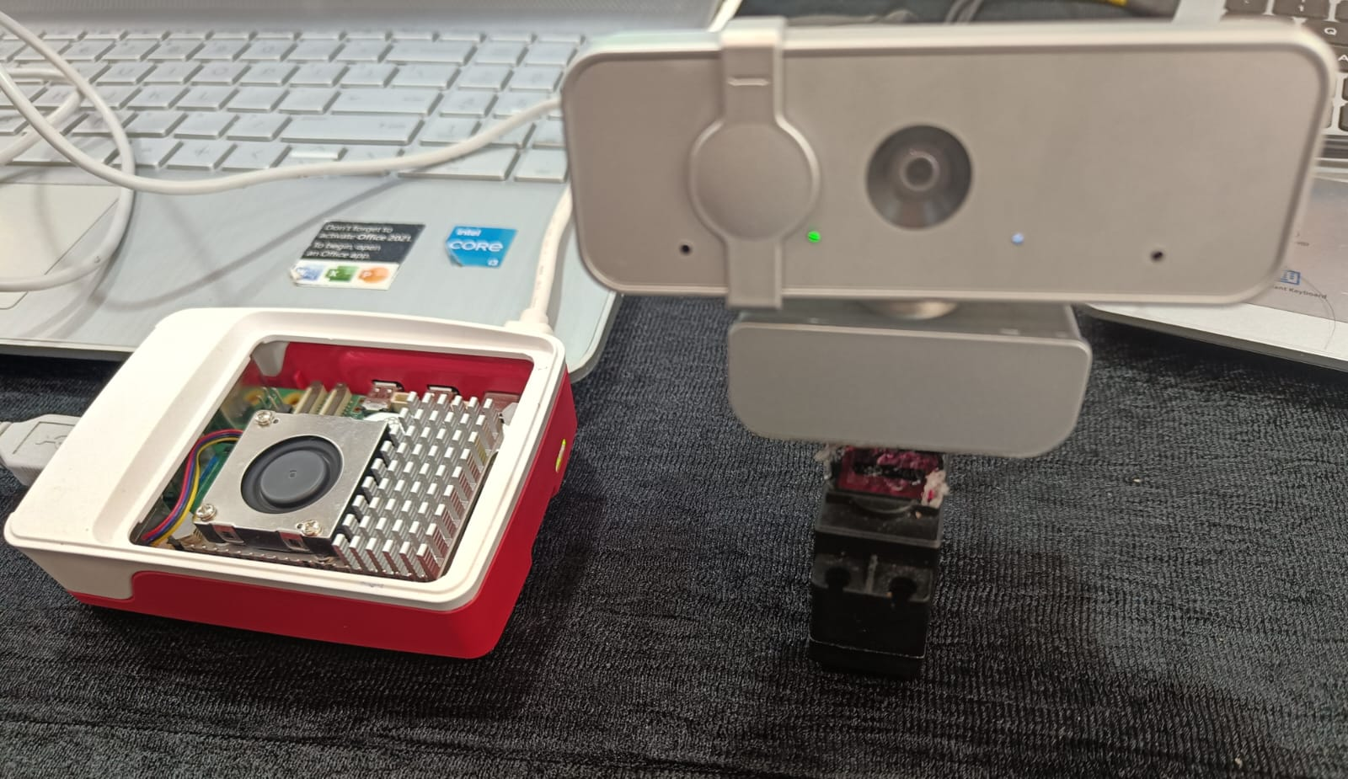
The Future of Stampede Prevention
1
Smarter Crowd Prediction
AI combined with real-time CCTV analytics will enable adaptive crowd-flow predictions, helping authorities respond before dangerous surges develop.
2
Smart Wearables for Safety
Smart badges, wristbands, or mobile apps can guide individuals away from high-density zones and send local panic-alerts instantly
3
Virtual Testing of Event Areas
Digital twins of stadiums and event grounds allow planners to simulate entry/exit flows and identify bottlenecks before the event begins.
4
Universal Safety Rules
National guidelines for density limits, alert thresholds, and crowd-monitoring tools will ensure consistent and safer management across large events.

